Slide 1
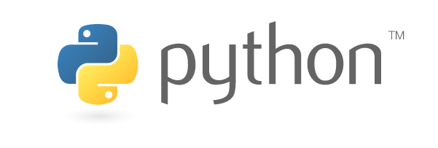
FAIM Python Workshop III – Image Processing
4 September 2019 | benjamin.titze@fmi.ch

Slide 2
Outline
Prerequisites: Python 3.6 and Jupyter Notebook.
Libraries: Pillow (PIL) and scikit-image; NumPy, SciPy, matplotlib
Digital image processing
Introduction to the libraries
Examples of common tasks (in Jupyter Notebook)
Loading, manipulating and saving images
Extracting image statistics
Applying filters
Object detection

Slide 3
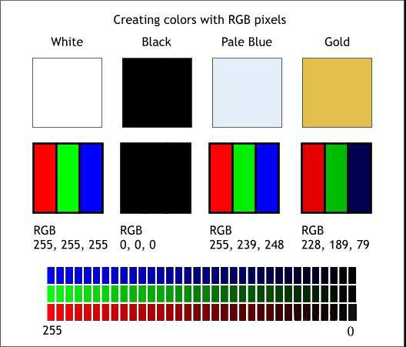
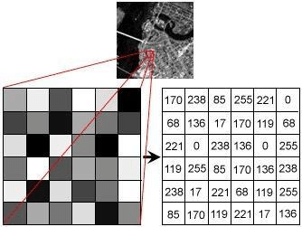
Illustration: Goutam Das
Illustration: www.panadisplay.com
A digital image is a 2D array of pixels.
Every pixel has a coordinate (x/y = column position/row position starting from 0/0 in upper left corner)
and an intensity value (typically 8 bit or 16 bit for greyscale, or 3 × 8 bit = 24 bit for RGB).

Slide 4
(Bio)Image Processing/Analysis
Loading images into memory for processing, saving (processed) image data from memory to disk, converting between formats and bit-depths (tiff, png, jpg…; 8-bit, 16-bit…)
Image manipulation:
Shape: Cropping, resizing, rotation, flipping, …
Brightness, contrast…
Image statistics: mean, standard deviation, histogram…
Applying filters: denoising, edge detection…
Extraction of relevant information: spot detection, segmentation…

Slide 5
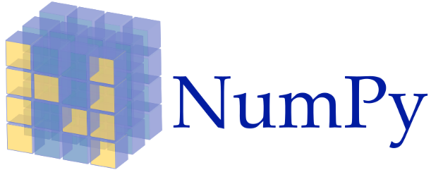


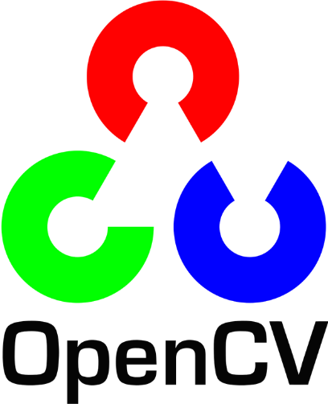

(pronounced Num Pie)
A library for fast manipulation of multidimensional numerical data. The basic type ndarray is a multidimensional array with zero-based indexing
(pronounced Sigh Pie)
A scientific computing library with various modules for numerical integration, linear algebra, image processing, Fourier transforms, signal processing, statistical functions…
Builds upon numpy arrays.
Open-source image processing toolkit with lots of useful functionality in one place.
Started out as a SciPy toolkit (= ‘scikit’) in 2009. Works very well with NumPy and SciPy.
https://scikit-image.org
OpenCV (CV for Computer Vision) is a cross-platform library written in C/C++, started by Intel, now developed by the non-profit OpenCV foundation.
https://opencv.org
Can be used in Python via opencv-python. Focused on real-time computer vision with applications such as facial and gesture recognition, object identification…
pillow is a fork of the Python Imaging Library (PIL), a project to provide basic imaging processing capabilities in Python. PIL was discontinued in 2011. The package is called ‘pillow’, but in Python it’s used with ‘import PIL’.
https://python-pillow.org

Slide 6
Hands-on examples in Jupyter Notebook:
Load, transform and save images with Pillow (PIL)
Images as NumPy arrays, image statistics, histograms
Applying filters and thresholds
Blob detection (count stars in Hubble image)
Segmentation example (nuclear division time series)

